Slide 1
Unicorn Companies Feature Analysis
Monika Singh
NYC data Science Academy, New York

Slide 2
Motivation
Coined in 2013 by venture capitalist Aileen Lee.
“Unicorn startup” refers to a private company valued at or over $1 billion
When Lee did her first count, there were very few unicorns.

Slide 3
Motivation
According to Get2Growth:
About 305 million startups are created annually.
About 472 million entrepreneurs in the world.
According to 2019 Investopedia statistics, about 90% of newly created startups do not succeed.

Slide 4
Goal
To identify the features that makes a startup unicorn.

Slide 5
Dataset
Data set: https://www.kaggle.com/datasets/deepcontractor/unicorn-companies-dataset
Observations: 1037
Features: 13

Slide 6
Features
Company
Valuation in Billions
Date Joined
Country
City
Industry
Investors
Founded Year
Total Raised
Financial Stage
Investors Count
Deal Terms
Portfolio Exits

Slide 7
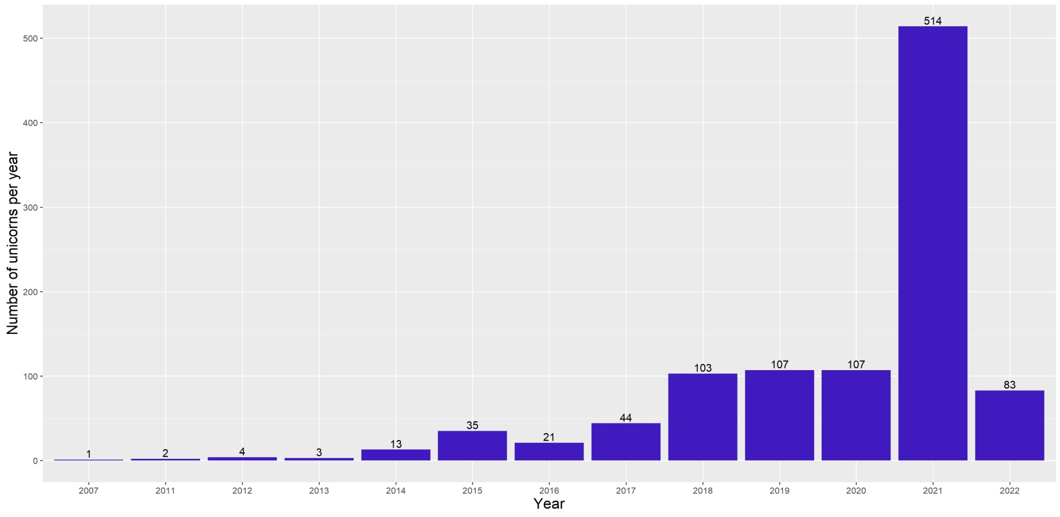
Number of unicorns per year

Slide 8
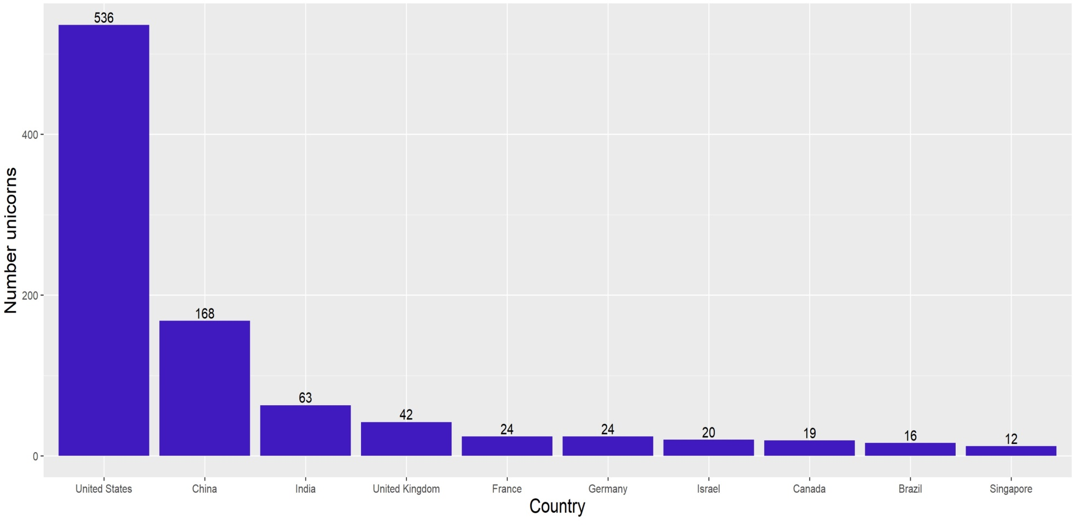
Unicorns per country

Slide 9
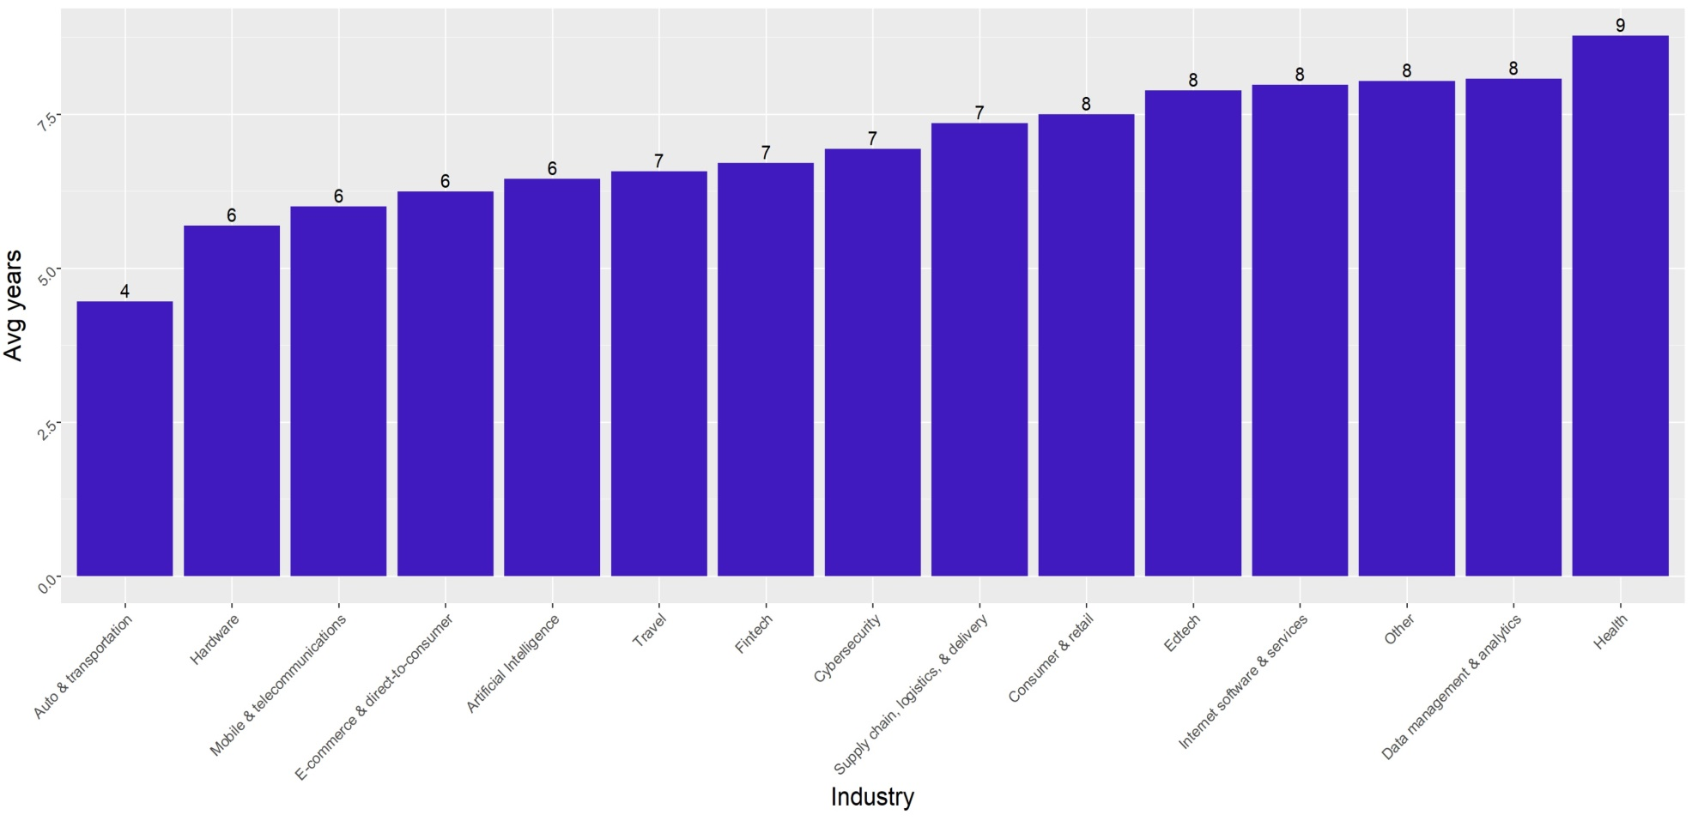
Industry

Slide 10
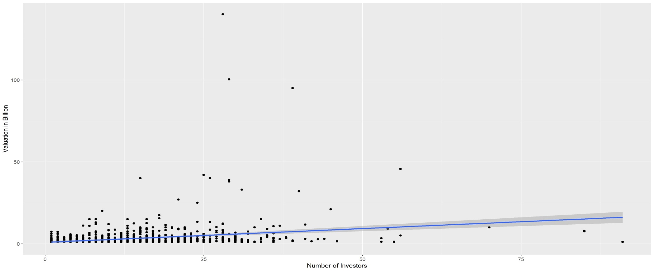
Valuation versus Number of Investors
Every new investor increases the valuation of the company by 167 million with the 95% confidence interval of 22 million.

Slide 11
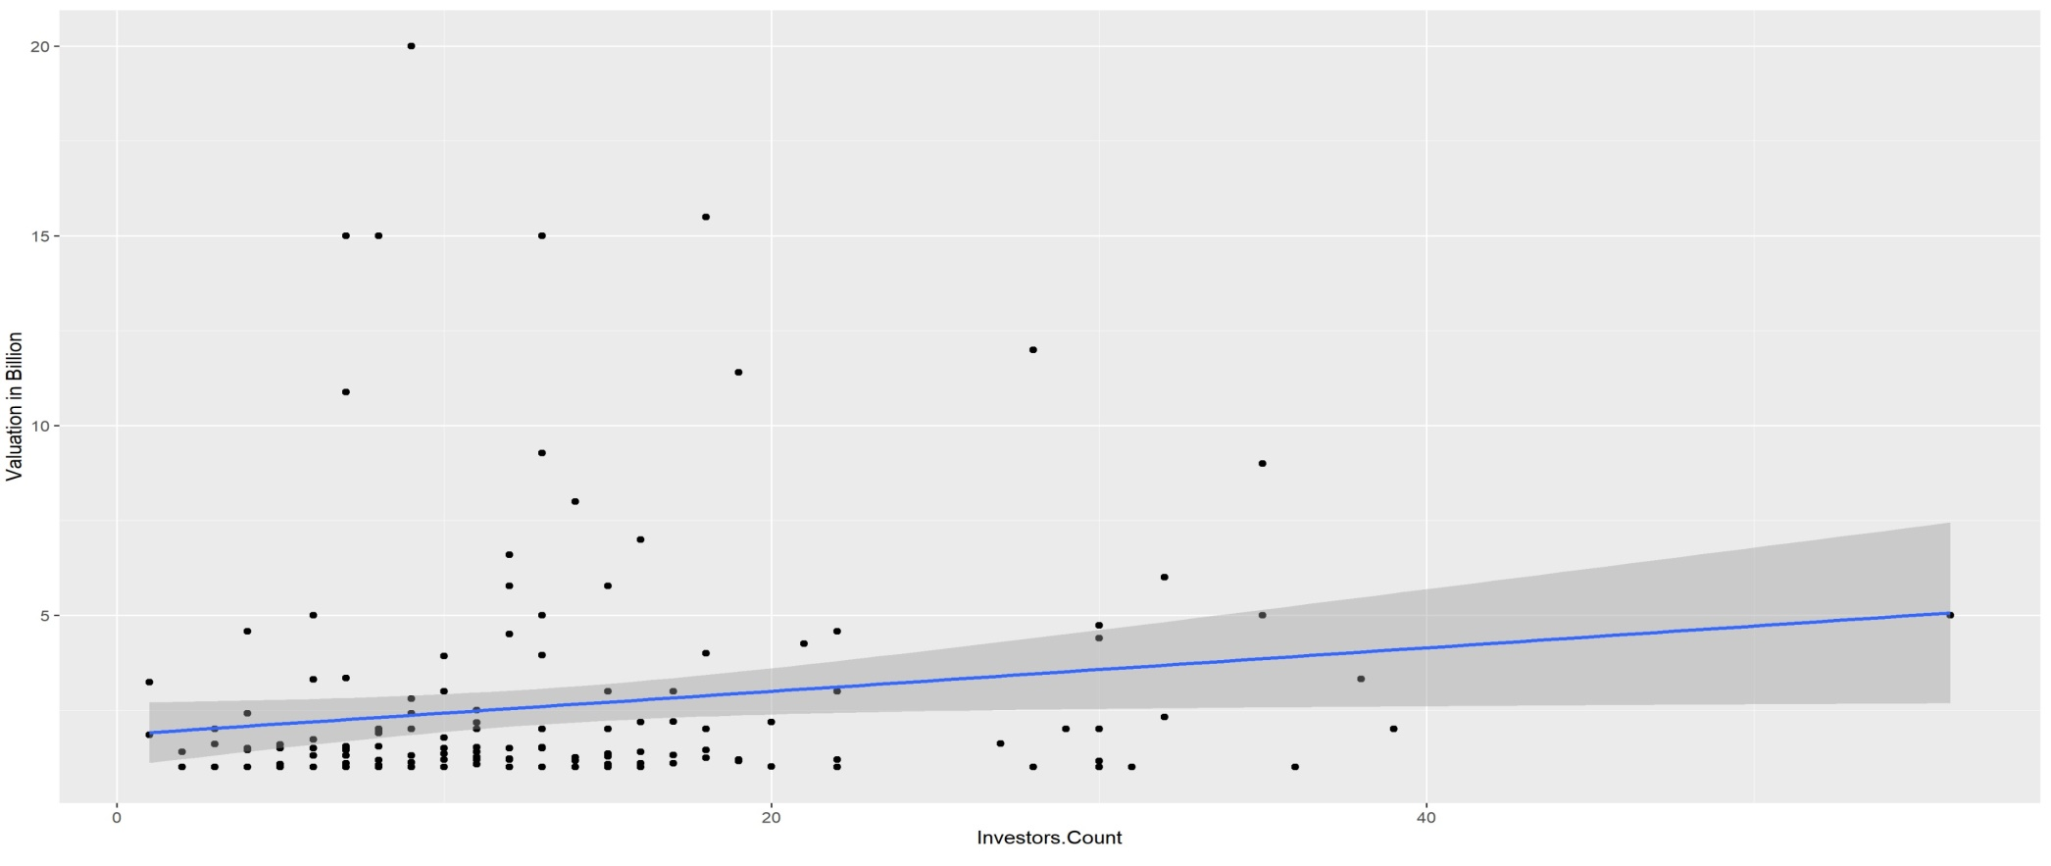
Valuation versus Number of Investors
Every new investor increases the valuation of the company by 57 million with the 95% confidence interval of 27 million.

Slide 12
Multi-variable analysis
Analysis of Number of Investors and Years since found on the valuation of the company.
Every new investor increases the valuation of the company by 185 million (while keeping number of years constant) with 95% confidence interval of 23 million.
Every year increases the valuation of a company by 136 million with 95% confidence interval of 38 millions.

